Slide 1
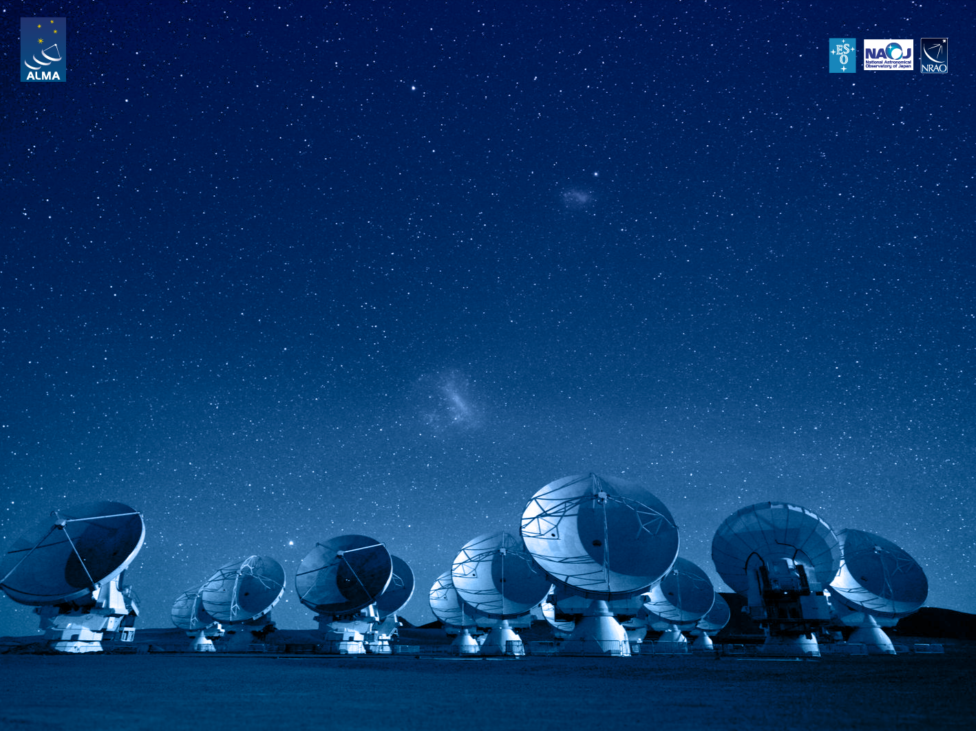
ALMA Common Software Basic Track
Test Driven Development
Unit testing and TAT

Slide 2
What is it?
In a nutshell
Development process that relies on very short development cycles
Tests written before functionality

Slide 3
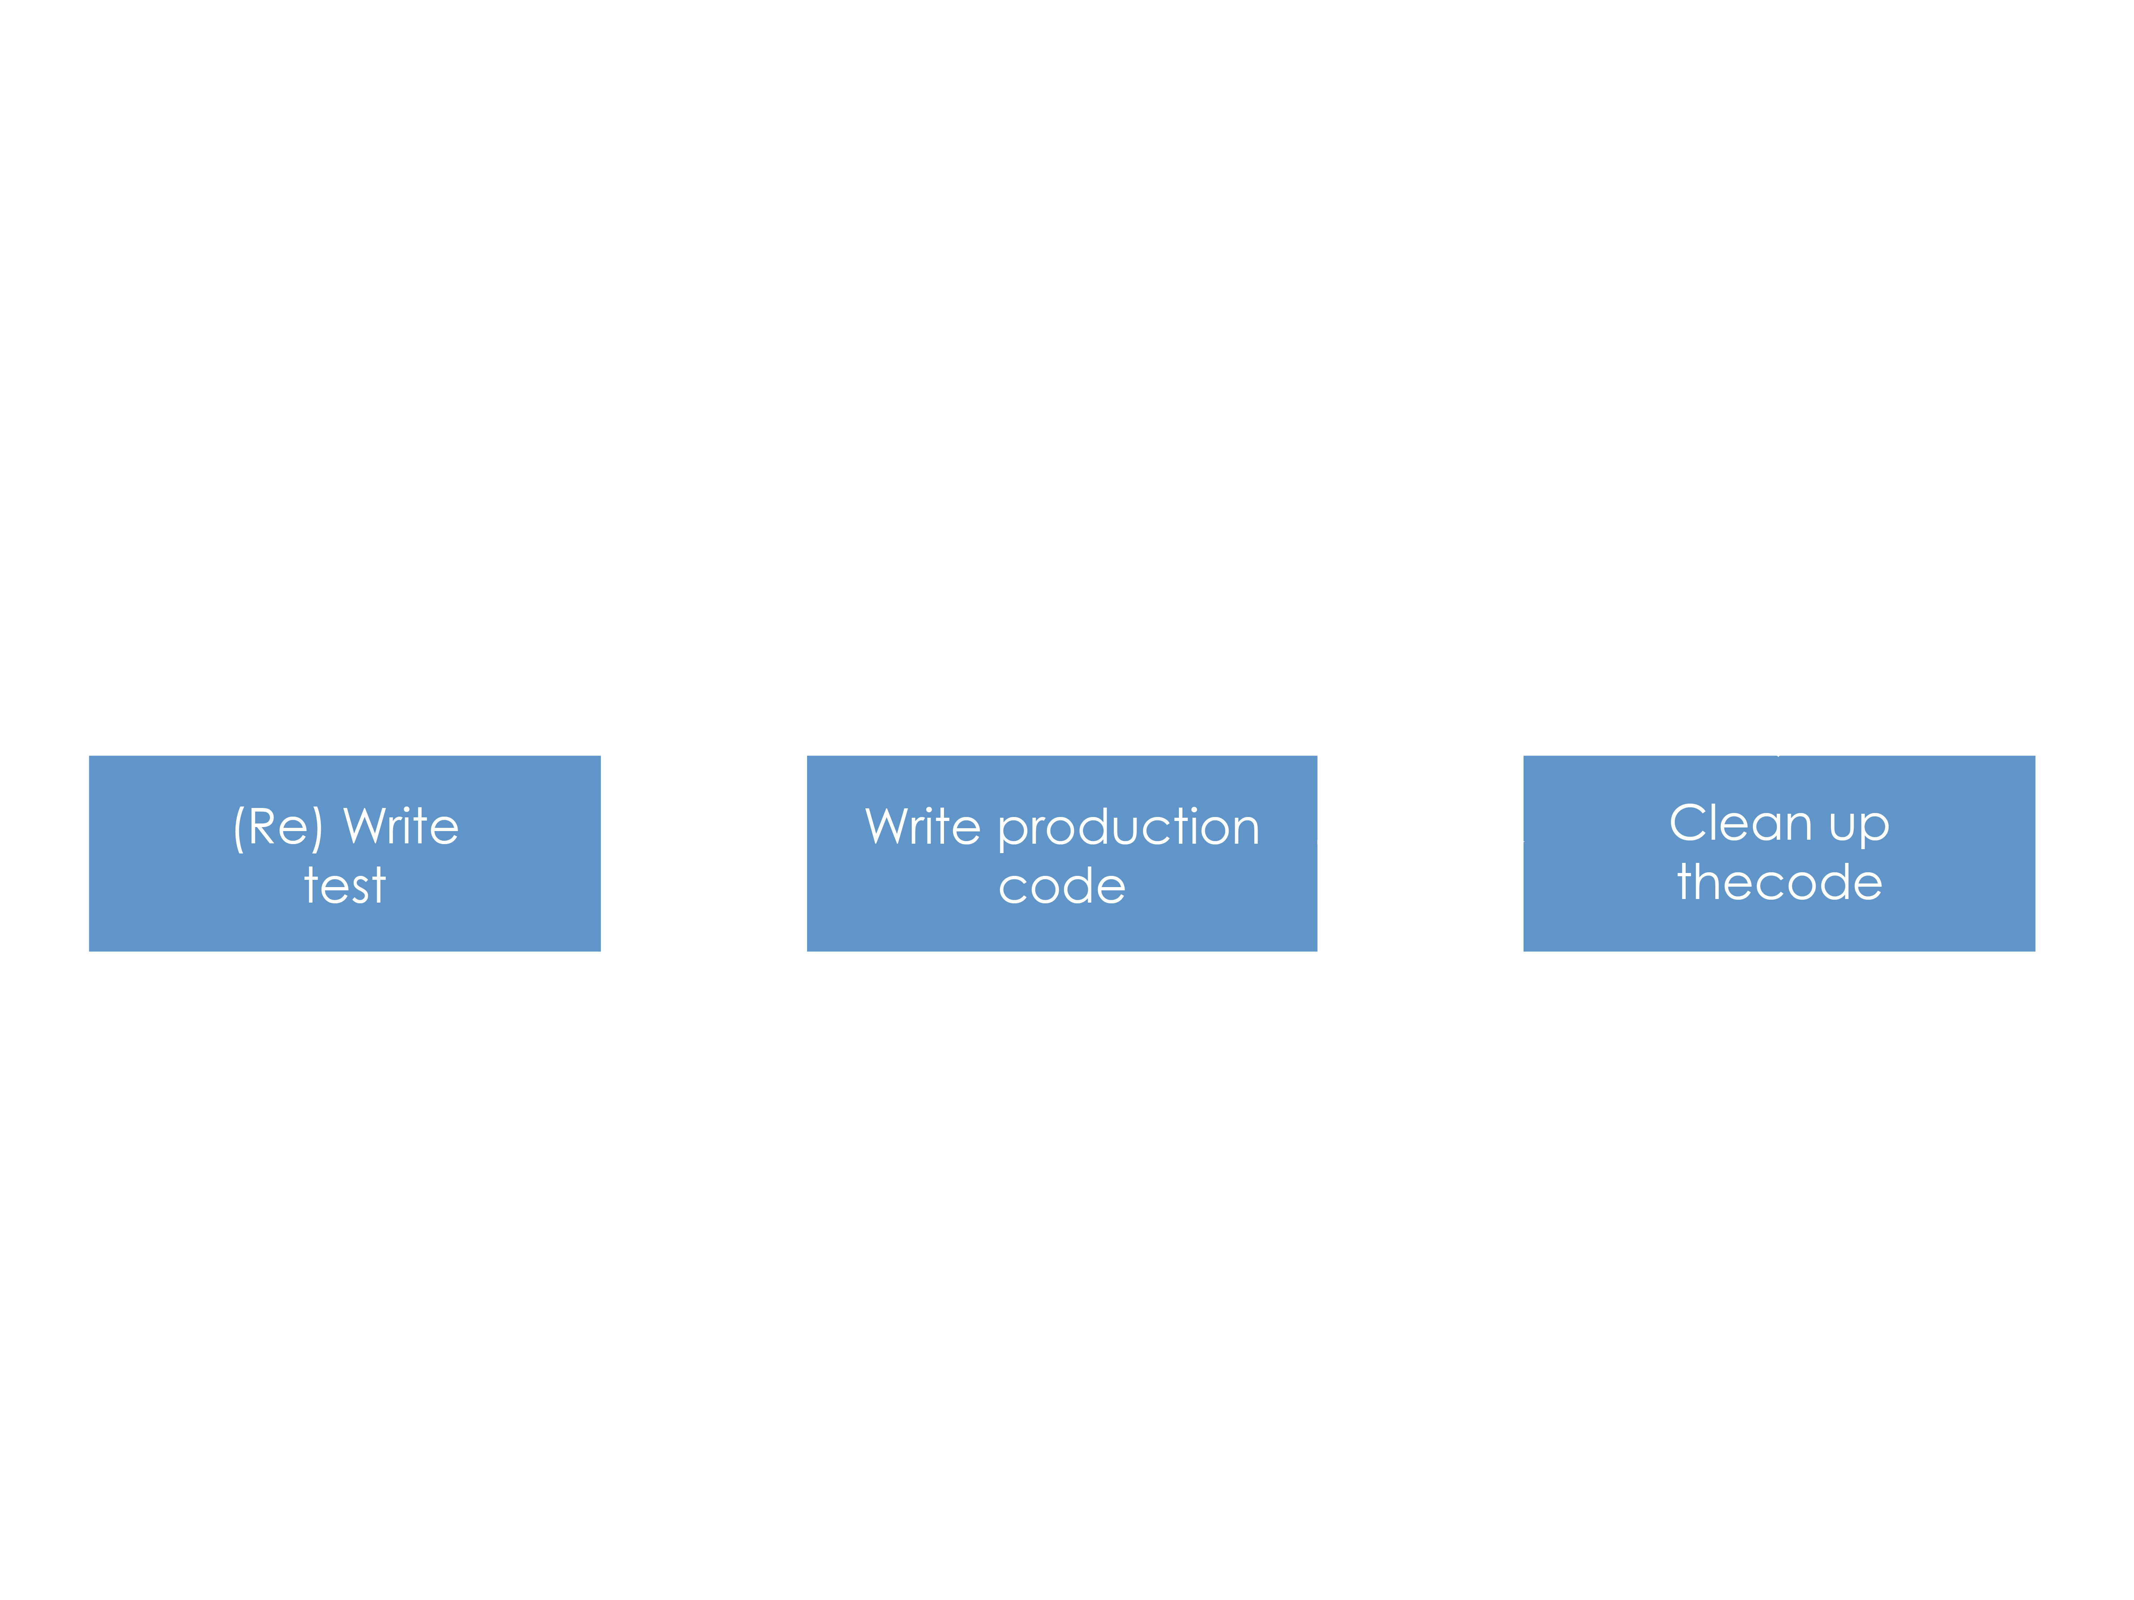
Workflow

Slide 4
How to test?
Unit testing
Atomic code functionality tests
xUnit code-driven testing framework:
CppUnit
jUnit
PyUnit

Slide 5
What to test? What not to test?
For sure:
Interfaces
Critical and/or non trivial portions of the code
Avoid testing:
Code without added value, such as getters/setters and delegations
Be cautious:
Over-testing is a waste of time

Slide 6
xUnit
Test case: basic unit
Test suite: set of tests that share the same test conditions
setup()
tearDown()
Assertions

Slide 7
ACS TAT
Automated test driver
Initializes environment (ACS)
Pass criteria based on comparing test output against an output template
Can also run other kind of tests besides xUnit-based ones

Slide 8
Integration Tests
Tests the interactions among software modules
Tests deployment configuration
Integration CDB
Hardware configuration, if necessary
Individual module unit tests must pass to integrate

Slide 9
Development team
Responsible for:
Adding (at least one!) unit test(s) for your component
Prepare a test environment
Run the test(s) until the work
Once tests pass, check in all your code, test code and relevant configurations (TAT files, CDB) to the project configuration server
Document your work right away and in parallel with the development!
Advise: When done, take a well deserve coffee break…

Slide 10
Integration and testing team
Responsible for:
Continuous (and automatic) integration
Quality control during development
Build every time changes are detected
Identifying compilation and failures against regression tests
Facilitating the parties responsible for the failure and more importantly the parties responsible for fixing it
Revert to the last working checkpoint in case of a failure
Advise: Use automated tools like Jenkins, the integration team key tool

Slide 11
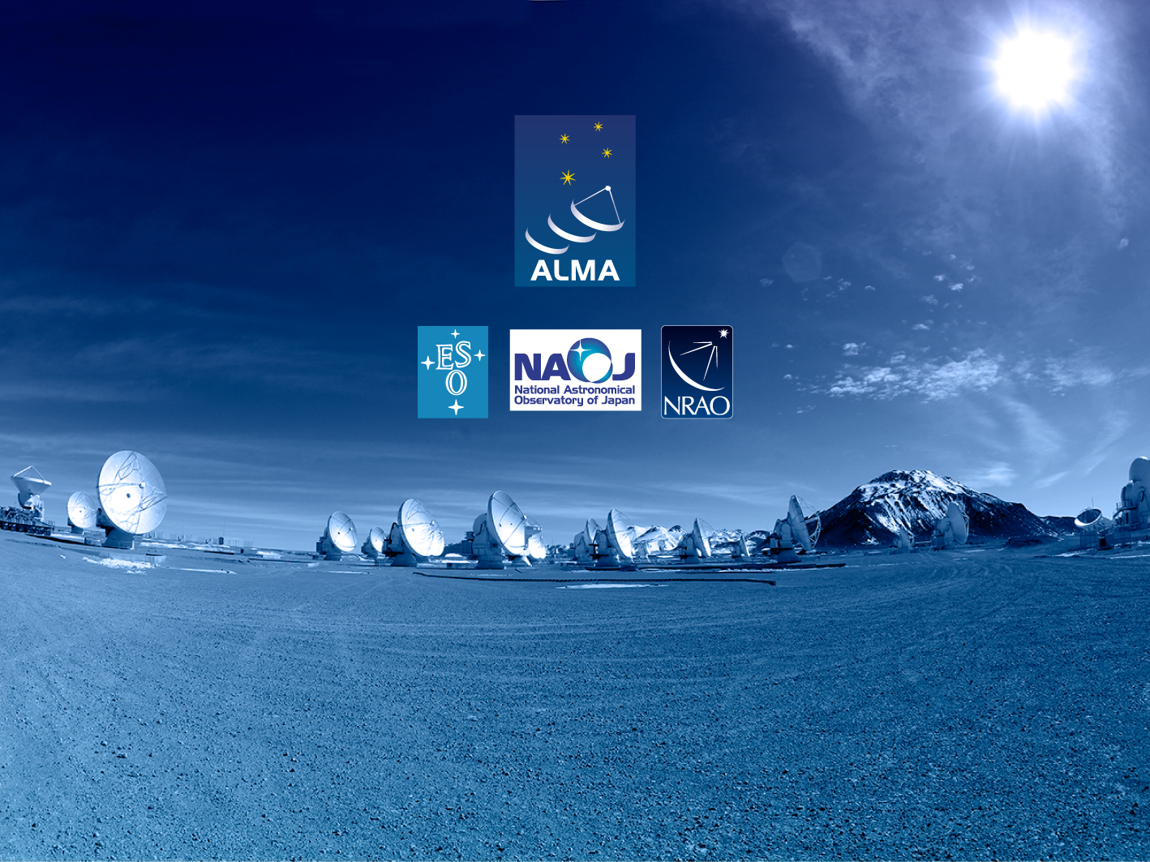
Questions?
Acknowledgements
ACS presentations were originally developed by the ALMA Common Software development team and has been used in many instances of training courses since 2004. Main contributors are (listed in alphabetical order): Jorge Avarias, Alessandro Caproni, Gianluca Chiozzi, Jorge Ibsen, Thomas Jürgens, Matias Mora, Joseph Schwarz, Heiko Sommer.
The Atacama Large Millimeter/submillimeter Array (ALMA), an international astronomy facility, is a partnership of Europe, North America and East Asia in cooperation with the Republic of Chile. ALMA is funded in Europe by the European Organization for Astronomical Research in the Southern Hemisphere (ESO), in North America by the U.S. National Science Foundation (NSF) in cooperation with the National Research Council of Canada (NRC) and the National Science Council of Taiwan (NSC) and in East Asia by the National Institutes of Natural Sciences (NINS) of Japan in cooperation with the Academia Sinica (AS) in Taiwan. ALMA construction and operations are led on behalf of Europe by ESO, on behalf of North America by the National Radio Astronomy Observatory (NRAO), which is managed by Associated Universities, Inc. (AUI) and on behalf of East Asia by the National Astronomical Observatory of Japan (NAOJ). The Joint ALMA Observatory (JAO) provides the unified leadership and management of the construction, commissioning and operation of ALMA.

